Slide 1
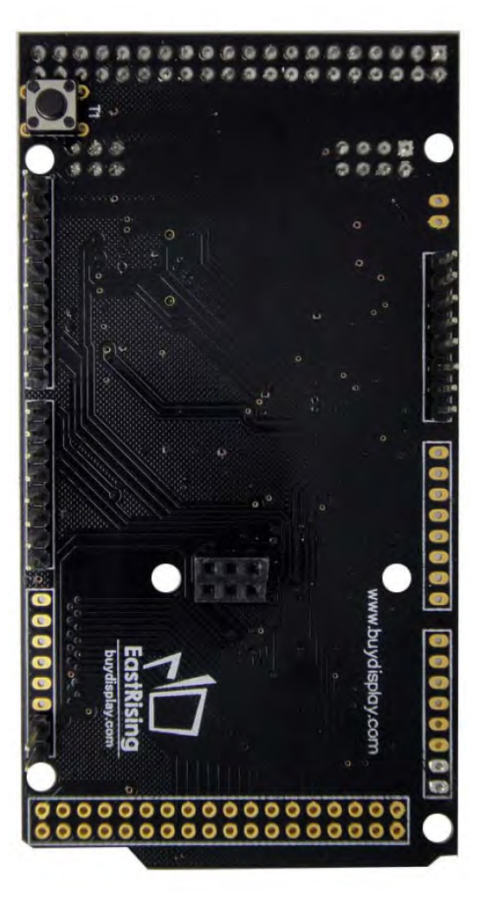
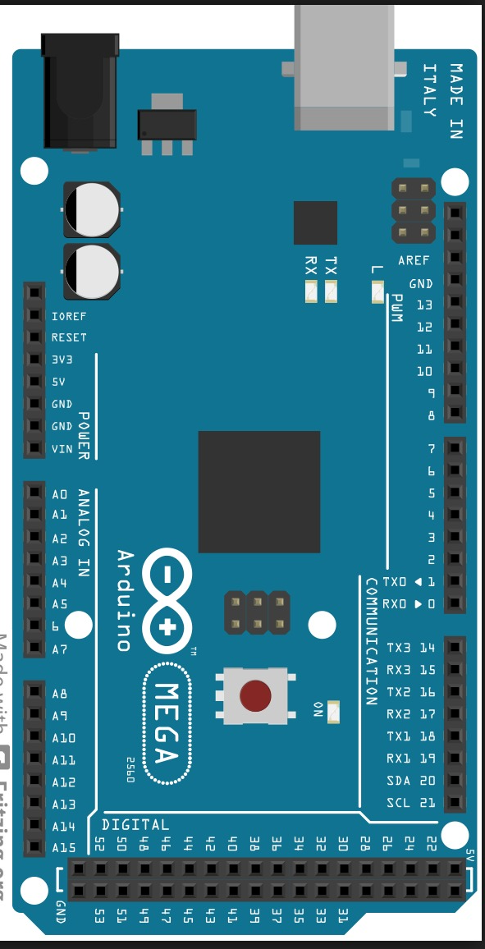

5V
gnd
JP8
JP4
1
1
JP7
1 gnd - lj
2 reset – az
3 mosi – cz
4 sck – roxo
5 Vcc – bc
6 miso - vm
JP5
1
1
X
1

